Slide 1
MIL-STD-1553B Demo

Slide 2
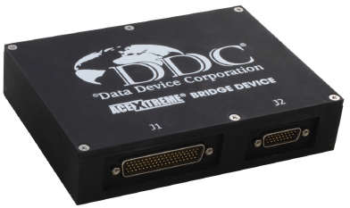
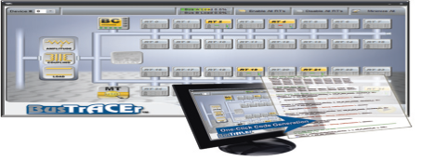


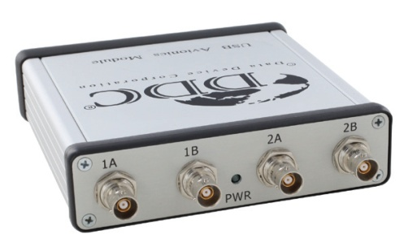
Demo 환경 구성 I : BC + MT
BU-671155W100L-CC0
( BC + MT )
DDC
GUI / SDK
ETH HUB
BUS A
BUS B
BU-67103U200L-JL0
( RT )
USB
<number>-23

Slide 3
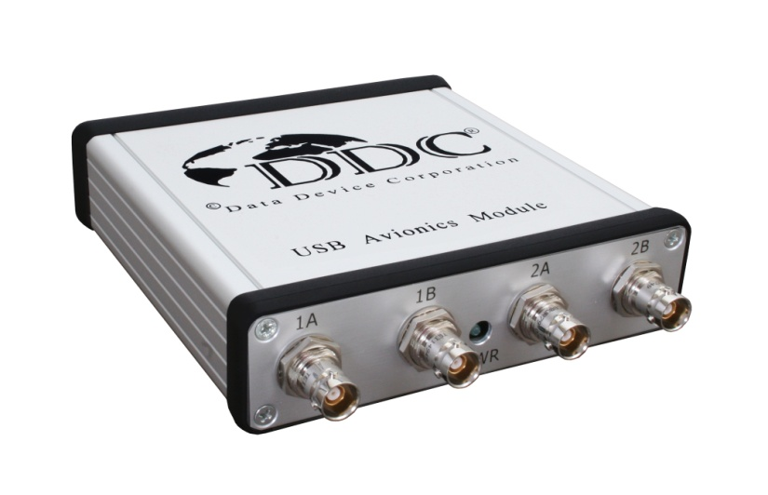
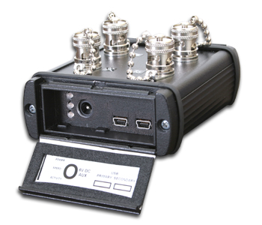
USB Avionics Interface
Multi I/O USB
  1 or 2 1553 Ch.
  IRIG-B Time Sync Input
  6 Discrete Digital I/O
Support SDK
  Window XP / 7 / 8 / 10
  Linux
C Software Development Kit
Windows GUI
High Level LabVIEW Software Interface
<number>-23

Slide 4
Window SDK 개요
AceXtreme ‘C’ Software Development Kit
  Part Number: BU-69092S0
구성
  Device Driver
  Application Programmers Interface (API)
  Library
  DDC Card Manager: Device Install, F/W Up
  Sample applications in ‘C’ source code
Supported Operating Systems
  Windows XP ~ Windows 10
<number>-23

Slide 5
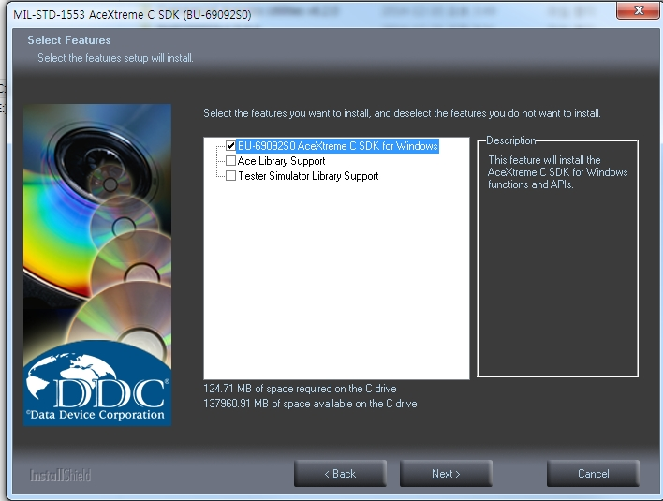
Window SDK 설치(1/6)
1. 압축 파일 해제
- BU-69092S0_4_4_1.zip
2. Setup.exe 실행
<number>-23

Slide 6


Window SDK 설치(2/6)
2. Host( PC ) IP 설정
In order to connect to the ABD for the first time, please set your host laptop/desktop to an IP address on the 192.168.1.x network.
(Recommended address: 192.168.1.90 netmask: 255.255.255.0
3. DDC ABD IP 확인
Default configuration for the ABD IP Address settings is as follows:
<number>-23

Slide 7
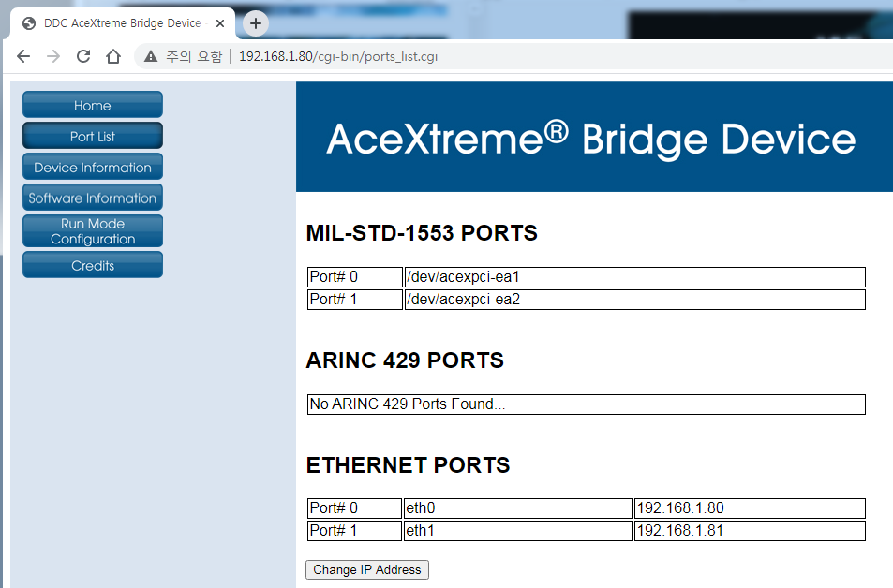
Window SDK 설치(3/6)
http://192.168.1.80/
<number>-23

Slide 8
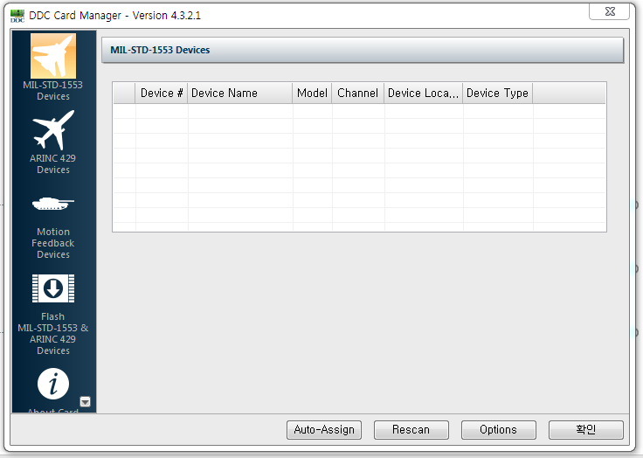
Window SDK 설치(4/6)
4. ddcc.exe 실행
- path: C:\DDC
<number>-23

Slide 9
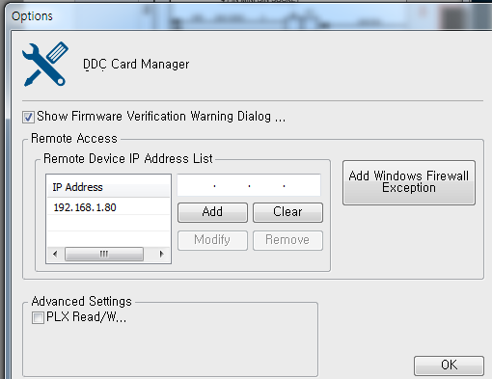
Window SDK 설치(5/6)
6. IP 설정 ( Remote Device IP )
<number>-23

Slide 10
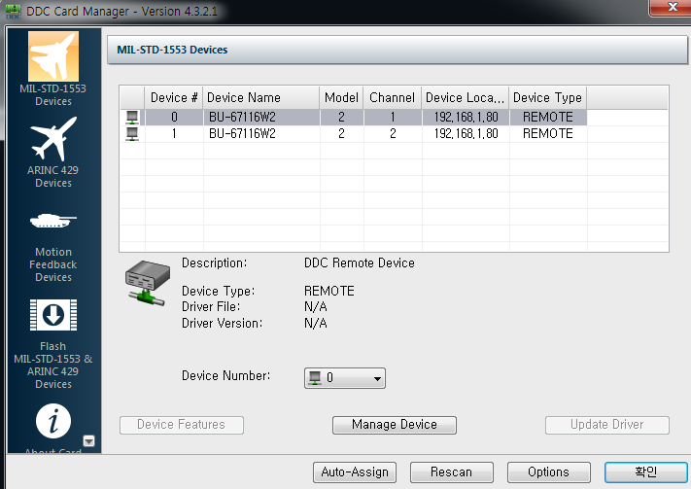
Window SDK 설치(6/6)
7. Device Number 지정: Device #0
<number>-23

Slide 11
Sample Applications: BC(1/2)
경로 :
  C:\DDC\aceXtremeSDKv4.4.1\samples\emacepl\src\bcdemo\bcdemo.c
기능
  BC 초기화
  Data 블록 생성
  Message 블록 생성
  Minor Frame 생성
  Major Frame 생성
  BC Start
<number>-23

Slide 12
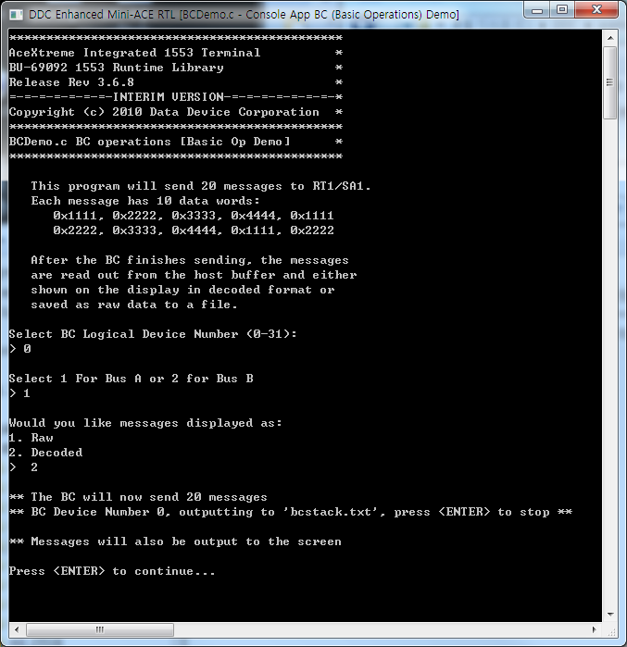
Sample Applications: BC(2/2)
Device Number
Bus A 또는 B 선택
Raw:
BC Message Block 을
직접 read.
Decoded:
BC Message Block을 Host Buffer 에 저장하여 Read
<number>-23

Slide 13
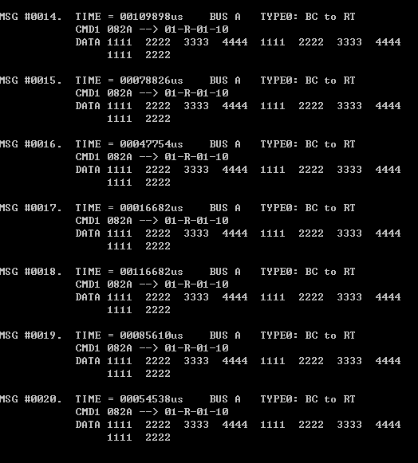
Sample applications: 결과 확인( 정상 )
메시지 개수: #1~#20
BUS A, B 중 A
01: RT Address
R : Receive( BC to RT )
01 : Subaddress
10 : Data Word Count
Data Word
<number>-23

Slide 14
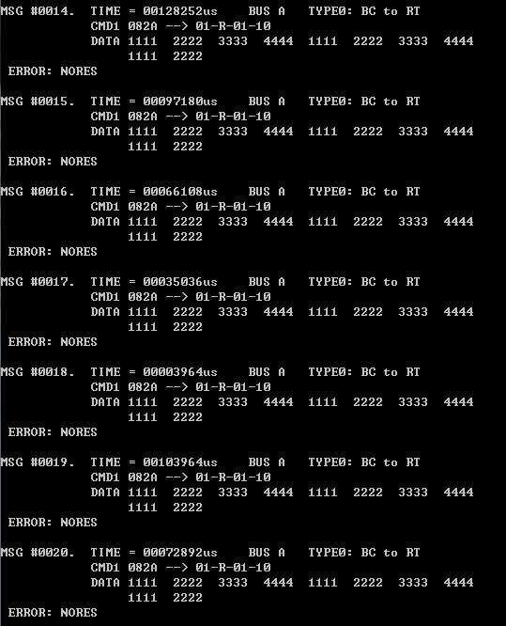
Sample applications: 결과 확인(실패)
BC 명령에 대해
RT에서의 응신 없음을 의미
<number>-23

Slide 15
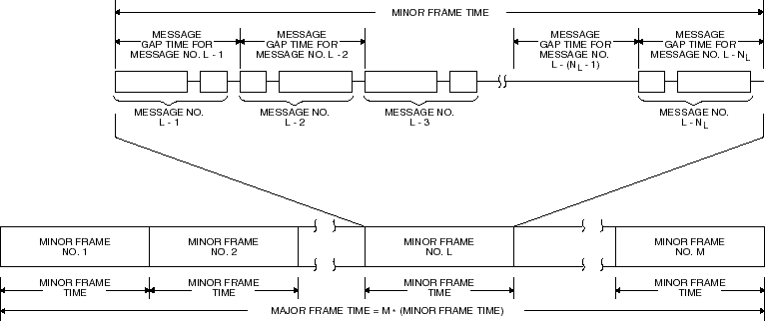
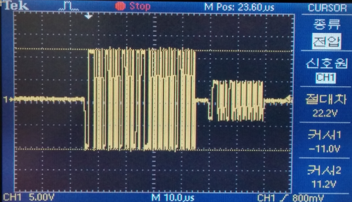
Frame 구조
최소 100 us 이상
<number>-23

Slide 16
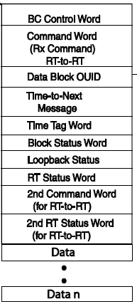
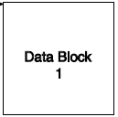
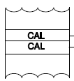
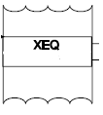
BC Message 설정
4
3
1
BC Data Block
aceBCDataBlkCreate(,DBLK1, , ,)
* Unique the block id, Must be>00
MAJOR FRAME
aceBCFrameCreate
(,MJR,,,,,)
MINOR FRAME #1
( XEQ
aceBCOpCodeCreate
(,OP1,,MSG1,,,)
MNR
aceBCFrameCreate
(,MNR1,,,,,)
CAL
aceBCOpCodeCreate
(,OP2,,MNR1,,,) )
Unique the block id, Must be>0
DBLKn, MSGn, OPn, MNRn, MJR
2
BC Message#1
aceBCMsgCreateBCtoRT(,MSG1, DBLK1,,,,,,)
BC Message#N
aceBCMsgCreateBCtoRT(,MSG2, DBLK2,,,,,,)
MINOR FRAME #n
( XEQ : aceBCOpCodeCreate(,OP3,,MSG2,,,)
MNR : aceBCFrameCreate(,MNR2,,,,,)
CAL : aceBCOpCodeCreate(,OP4,,MNR2,,,) )
<number>-23

Slide 17
BC API Flow : BcDemo.c
Initialize Device
aceInitialize()
Create Host Buffer
aceBCInstallHBuf()
Create data block
aceBCDataBlkCreate()
Create message block
aceBCMsgCreateBCtoRT()
OPCODE_CAL
aceBCOpCodeCreate()
Create MINOR FRAME
aceBCFrameCreate()
OPCODE_XEQ
aceBCOpCodeCreate()
Minor frame time이 0 이면 Major frame time 에 설정된 값으로 적용
☞ 100 us offset, 즉 설정값 200 : 20 ms
Create MAJOR FRAME
aceBCFrameCreate()
aceBCStart()
aceBCGetHBufMsgDecoded()
Major frame time이 0 이면 Minor frame time 에 설정된 값으로 적용
☞ 100 us offset, 즉 설정값 200 : 20 ms
aceBCStop()
aceBCDataBlkRead(),
aceBCDataBlkWrite()
<number>-23

Slide 18
Demo 환경 구성 II : Register & Mem Test
경로 :
  C:\DDC\aceXtremeSDKv4.4.1\samples\emacepl\src\tester\tester.c
기능
  Test Mode
  Registers
  Memory
  Interrupts
DDC
GUI / SDK
ETH HUB
<number>-23

Slide 19
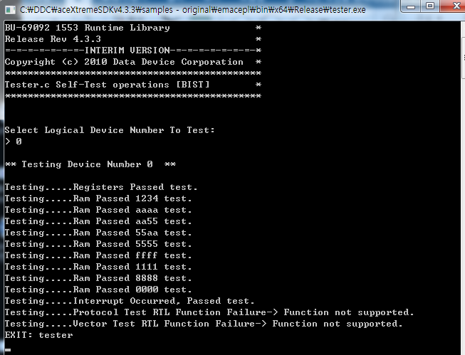
Sample applications: 결과 확인
<number>-23

Slide 20

Demo 환경 구성 III : Loop Test
BU-671155W100L-CC0
( Test Mode )
DDC
GUI / SDK
ETH HUB
BUS A
BUS B
<number>-23

Slide 21
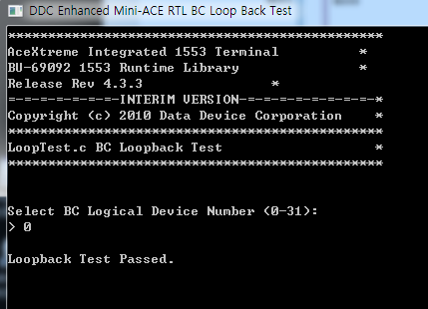
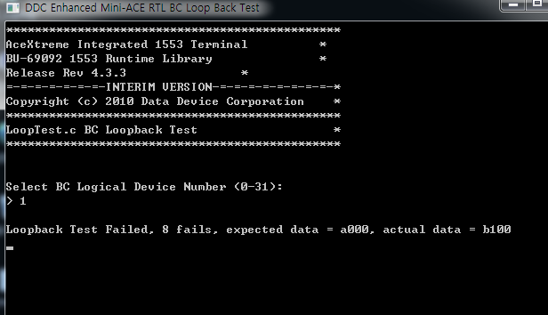
Sample applications: 결과 확인( 정상 )
<number>-23

Slide 22
GUI S/W: BusTrACEr™(1/6)
MIL-STD-1553 Data Bus Analyzer and Monitor software
Graphical user interface (GUI)
Tester Simulator
  Bus Controller
  All 31 Remote Terminals
  Bus Monitor
One-click generation of ANSI ‘C’ source code
<number>-23

Slide 23
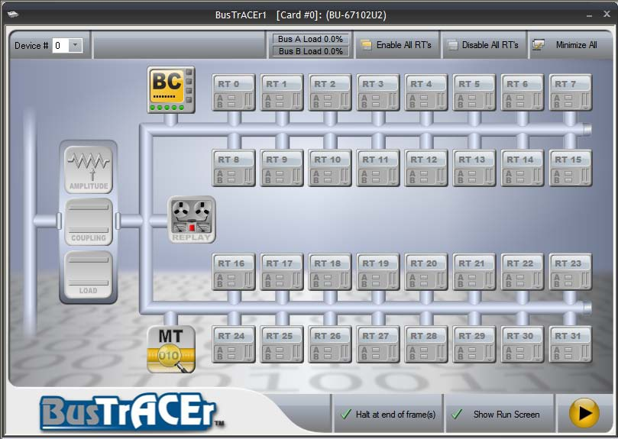
GUI S/W: BusTrACEr™(2/6)
Main Dialog
<number>-23

Slide 24
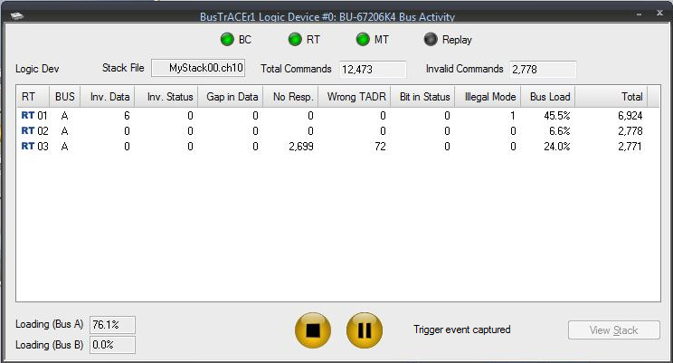
GUI S/W: BusTrACEr™(3/6)
BUS Active Screen
<number>-23

Slide 25
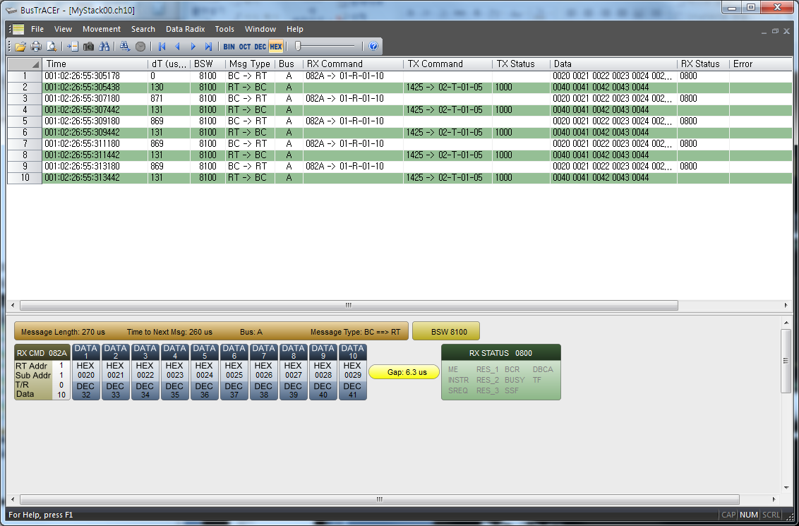
GUI S/W: BusTrACEr™(4/6)
View Stack
<number>-23

Slide 26
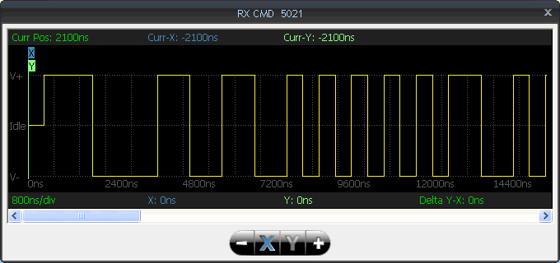
GUI S/W: BusTrACEr™(5/6)
Waveform Viewer
<number>-23

Slide 27
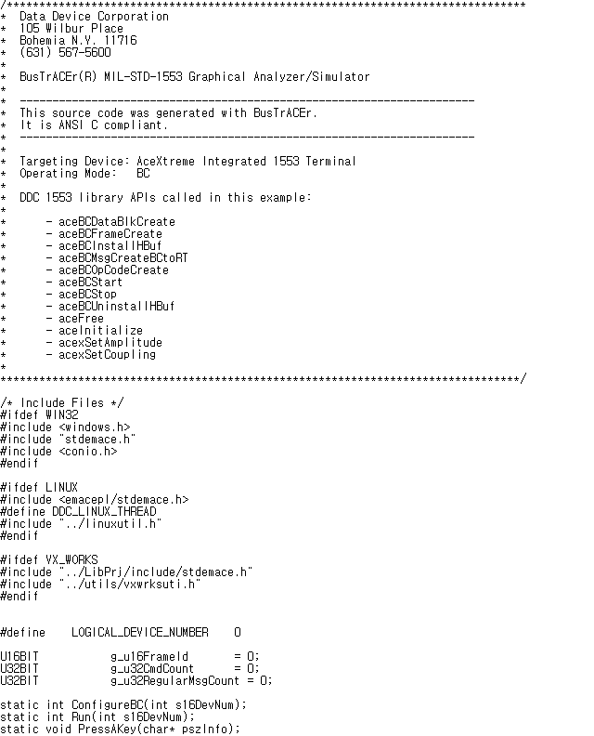
GUI S/W: BusTrACEr™(6/6)
Generating ‘C’ Source Code File
<number>-27

